Slide 1
Linguistics 201
Phonology 3
Francisco Torreira

Slide 2
Logistics
Conference 2 this Friday with your TA
Phonology problems:
Phonemic analysis of Inuktitut, Mokilese, Gascon, and Hindi datasets
Please attend a different section if you feel yours is too crowded
Assignment 1 grades
You may notice slight changes in your Assignment 1 grade this week, as we may need to regrade some questions manually e.g.
Question involving the vowel in bed: typo in answer key
Question

Slide 3
Today
General types of phonological processes
Assimilation, coalescence, lenition, fortition, deletion, epenthesis
Not in Phonology supplementary reading
Take notes; feel free to use online resources e.g. Assimilation article on Wikipedia
The syllable
Definition
Types of syllables
Internal structure (i)

Slide 4
Phonological processes
Phonemes may display allophonic variation
Some general types:
Assimilation two adjacent segments become more similar
Coalescence two adj. segments merge into one
Lenition consonantal weakening
Fortition consonantal strengthening
Deletion a segment is deleted
Epenthesis a segment is inserted

Slide 5
Assimilation
Nasal place assimilation In English:
English d/t palatalization before /j/:

Slide 6
Phonological processes
Some general types:
Assimilation two adjacent segments become more similar
Coalescence two adj. segments merge into one
Lenition consonantal weakening
Fortition consonantal strengthening
Deletion a segment is deleted
Epenthesis a segment is inserted

Slide 7
Coalescence
Two segments merge into one (fusion):
Zsiga (2013:235)

Slide 8
Phonological processes
Phonemes may display allophonic variation
Some general types:
Assimilation two adjacent segments become more similar
Coalescence two adj. segments merge into one
Lenition consonantal weakening
Fortition consonantal strengthening
Deletion a segment is deleted
Epenthesis a segment is inserted

Slide 9
Lenition
Consonantal weakening, usually affecting manner (e.g. from full to narrow / partial / shorter constriction)*:
Voiceless stop Lenition in Florentine Italian
i.e. Voiceless stops (full constriction) become fricatives (narrow constriction) whenever they occur between vowels
* Or place e.g. loss of supraglottal constriction /s/ > [h] in Andalusian Spanish (see examples in slide 13)

Slide 10
Phonological processes
Some general types:
Assimilation two adjacent segments become more similar
Coalescence two adj. segments merge into one
Lenition consonantal weakening
Fortition consonantal strengthening
Deletion a segment is deleted
Epenthesis a segment is inserted

Slide 11
Fortition
Consonantal strengthening (narrow to full constriction; lengthening; addition of phonetic features like aspiration)
e.g. Lenition, fortition, and stress in English
Lenition: /t/ and /d/ → [ɾ] word-medially AND beginning of unstressed syllable
Fortition: /t/ → [t^{h}] at beginning of stressed syllables OR word-initially

Slide 12
Phonological processes
Phonemes may display allophonic variation
Some general types:
Assimilation two adjacent segments become more similar
Coalescence two adj. segments merge into one
Lenition consonantal weakening
Fortition consonantal strengthening
Deletion a segment is deleted
Epenthesis a segment is inserted

Slide 13
Deletion
A segment is deleted from the segmental string
Syllable-final /s/-aspiration (case of lenition; loss of supraglottal constriction) and deletion Andalusian Spanish:
las casas /las kasas/ [lahkasa] ‘the houses’
los otros /los otros/ [lohotro] ‘the others’
el viernes /el bjernes/ [el bjerne] ‘(the) Friday’
Aspiration: /s/ → [h] utterance-medially
Deletion: /s/ → [Ø] (null sign) utterance-finally (before pause)

Slide 14
Phonological processes
Phonemes may display allophonic variation
Some general types:
Assimilation two adjacent segments become more similar
Coalescence two adj. segments merge into one
Lenition consonantal weakening
Fortition consonantal strengthening
Deletion a segment is deleted
Epenthesis a segment is inserted

Slide 15
Epenthesis
Spanish speakers insert [e] before sC clusters
C represents “consonant”
Phenomenon observed in loanwords and inter-language phonology:
Origin Spanish
schola (Latin) /eskwela/
sphera (Latin) /esfera/
standard (English) /estandar/
Scott (English) /eskot/

Slide 16
Phonological processes
Some general types:
Assimilation two adjacent segments become more similar
Coalescence two adj. segments merge into one
Lenition consonantal weakening
Fortition consonantal strengthening
Deletion a segment is deleted
Epenthesis a segment is inserted

Slide 17
The syllable
Important phonological unit that groups consonants and vowels in particular structures
Syllables form the basis for metrical structure in spoken language, poetry, and song
w = weak
s = strong
Foot
Syllable
Ladd (2008)
Metrical grid of the word baby sitter

Slide 18
The syllable
Liberman & Prince (1977)
Tune-text alignment
or
?

Slide 19


The syllable
Tune-text alignment
In poetry and song, stressed syllables (e.g. dʒɑ and pæ) are typically aligned with strong metrical positions e.g. downbeats
or
?

Slide 20
The syllable
Phonological processes are often sensitive to syllable structure
e.g. Allophonic variation of /t/ in English
e.g. Syllable-final /s/ aspiration and deletion Andalusian Spanish:
las casas /las kasas/ [lahkasa] ‘the houses’
los otros /los otros/ [lohotro] ‘the others’
el viernes /el bjernes/ [el bjerne] ‘(the) Friday’
s-aspiration: /s/ → [h] utterance-medially
s-deletion: /s/ → [Ø] utterance-finally (before a pause)

Slide 21
The syllable
Syllables typically consist of a vowel (V) preceded and/or followed by a number of consonants (C)
e.g. ə.tɑ.mɪk jɛs.tɚ.dej tə.mɑ.ɹow
In each language, only certain syllable types (e.g. V, CV, CVC, CCVC) are possible, and specific sounds are possible only in certain syllabic positions

Slide 22
Types of syllables patterns
Hawaaian follows a strict (C)V pattern:
aloha
/a.lo.ha/
/V.CV.CV/
All Hawaaian words are composed of syllables containing either a vowel, or a consonant plus a vowel
C = Consonant
V = Vowel

Slide 23
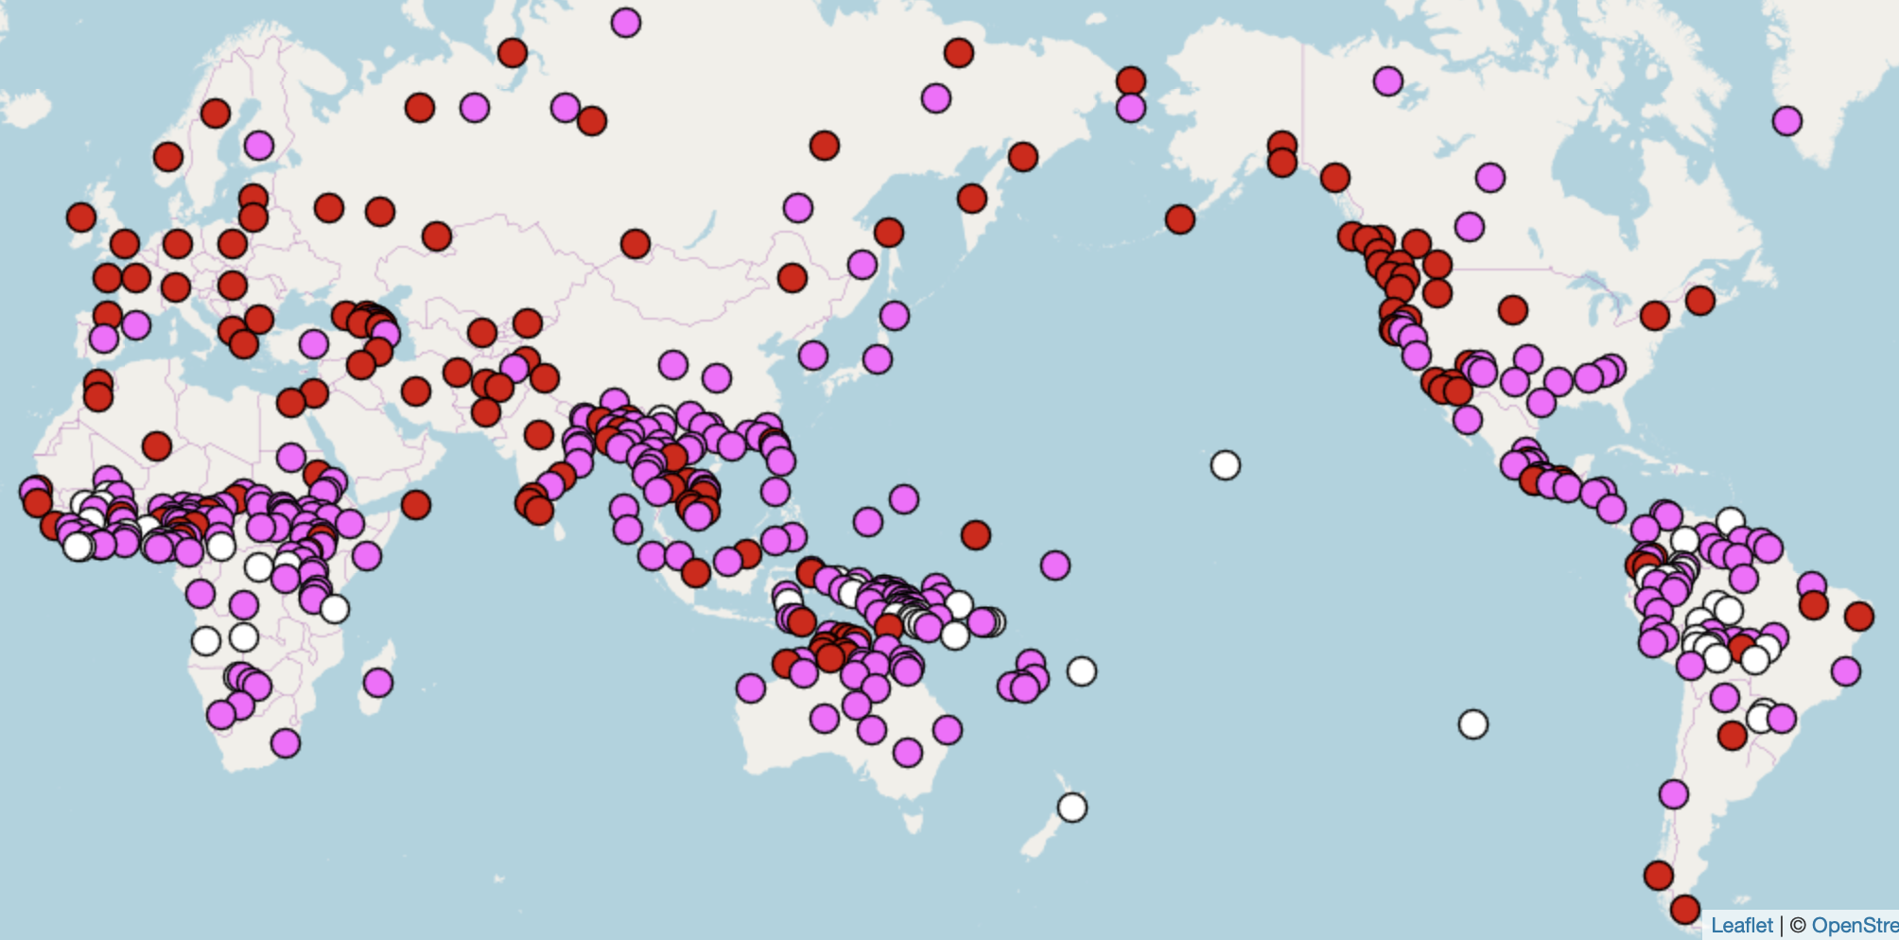
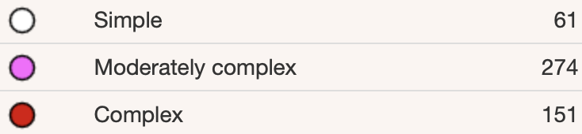
Syllable structure across the world
Hawaaian
CV
CVC / CCV / CCVC
CCCVCCCC
https://wals.info/

Slide 24
Types of syllables patterns
Korean has a more complex (C)V(C) pattern:

Slide 25
Syllable structure across the world
French
Korean
Hawaaian
CV
CVC / CCV / CCVC
CCCVCCCC
https://wals.info/

Slide 26
Types of syllables patterns
French allows for even more complex syllables:

Slide 27
Syllable structure across the world
French
Korean
Hawaaian
CV
CVC / CCV / CCVC
CCCVCCCC
https://wals.info/

